Slide 1
Vanadium figures

Slide 2
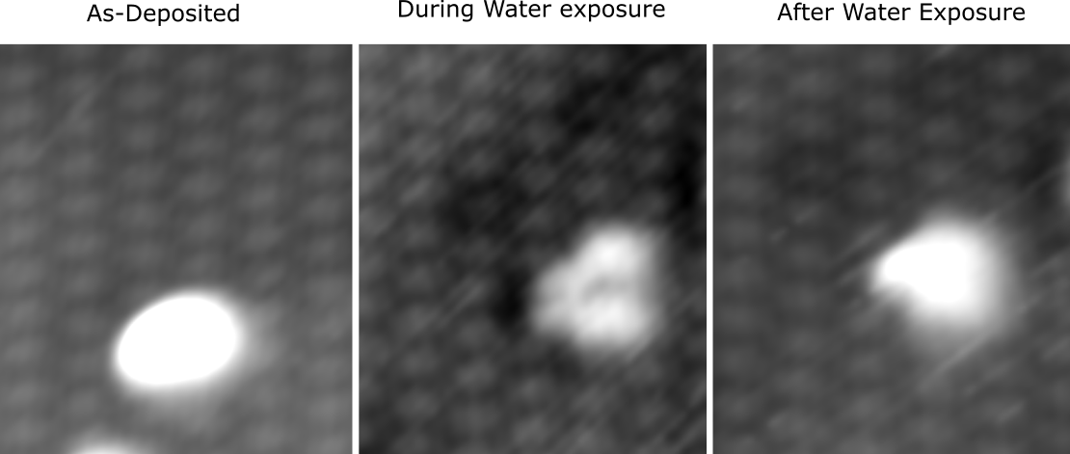

Slide 3
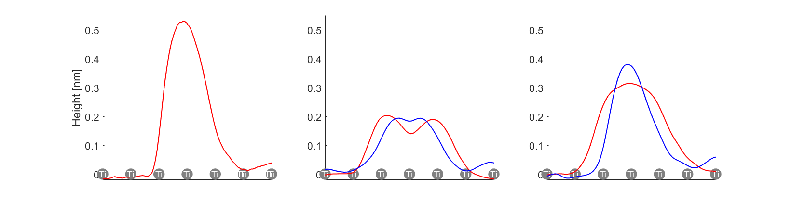

Slide 4
model suggestions
= V
V2O5
2 X VO3H
V2O5

Slide 5
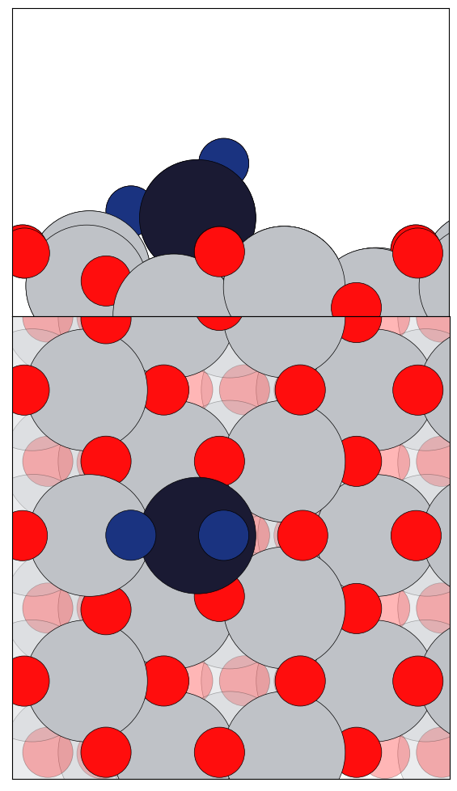
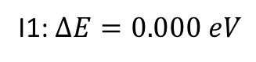
VO₂ Clusters with O_{v} (1by2 Super cell)
I1: $∆E=0.000 eV$

Slide 6
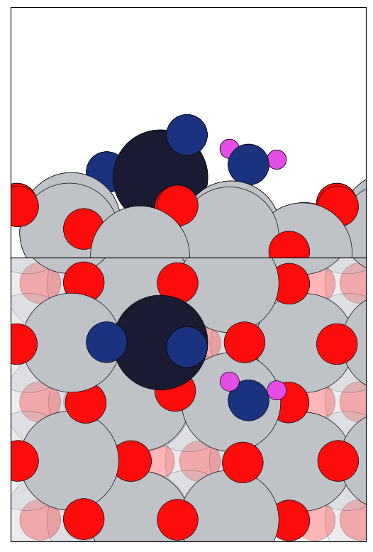
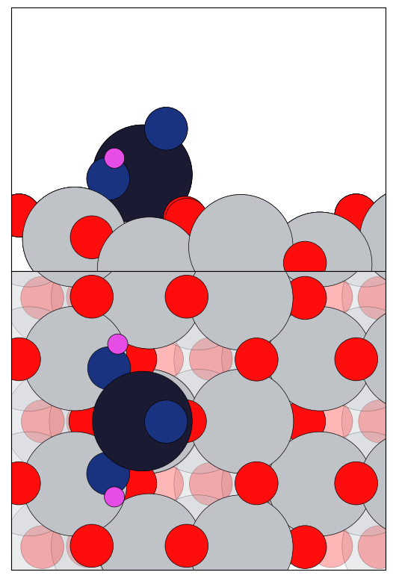
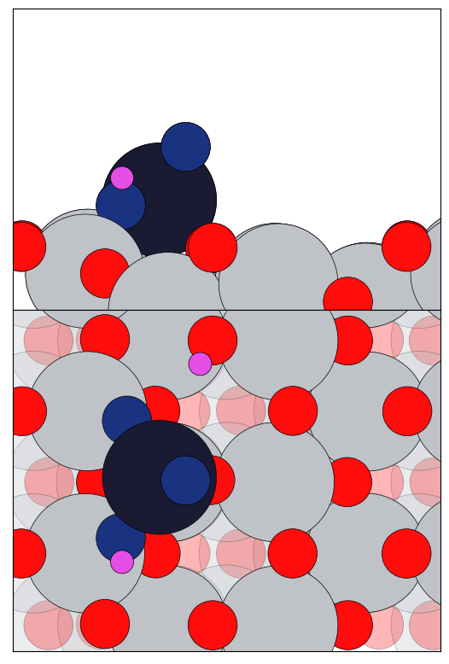
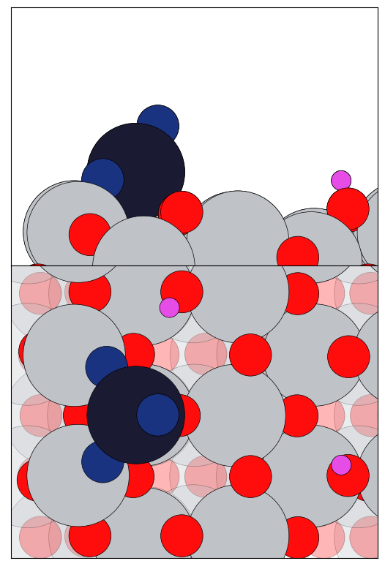
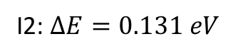
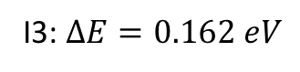
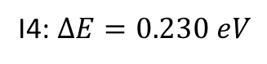
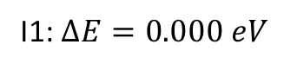
VO₂ + H₂O Clusters with O_{v} (1by2 Super cell)
I1: $∆E=0.000 eV$
I2: $∆E=0.131 eV$
I3: $∆E=0.162 eV$
I4: $∆E=0.230 eV$

Slide 7
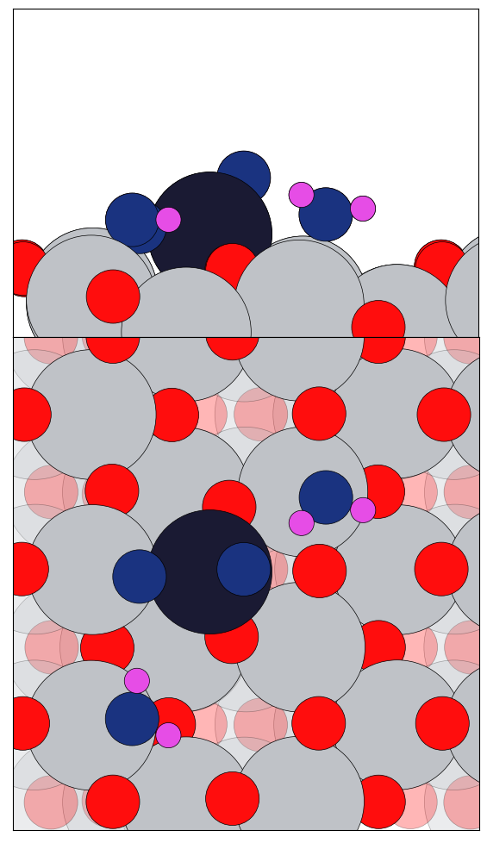
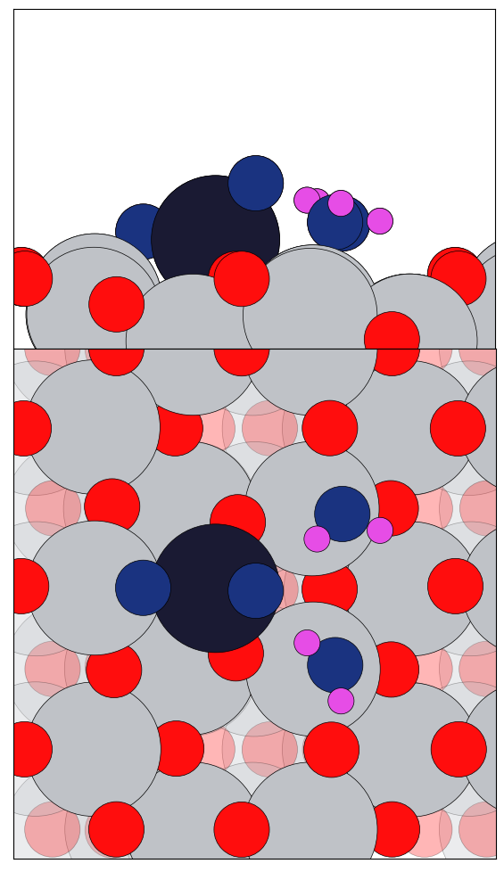
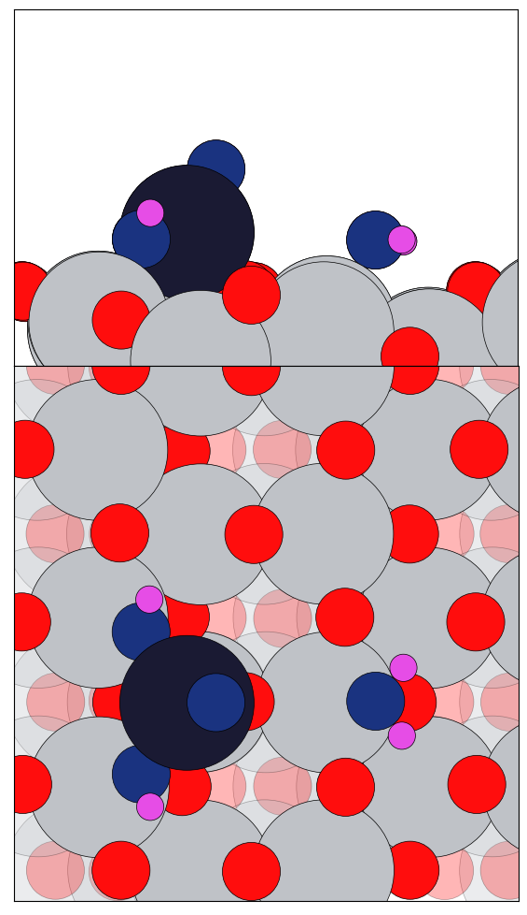
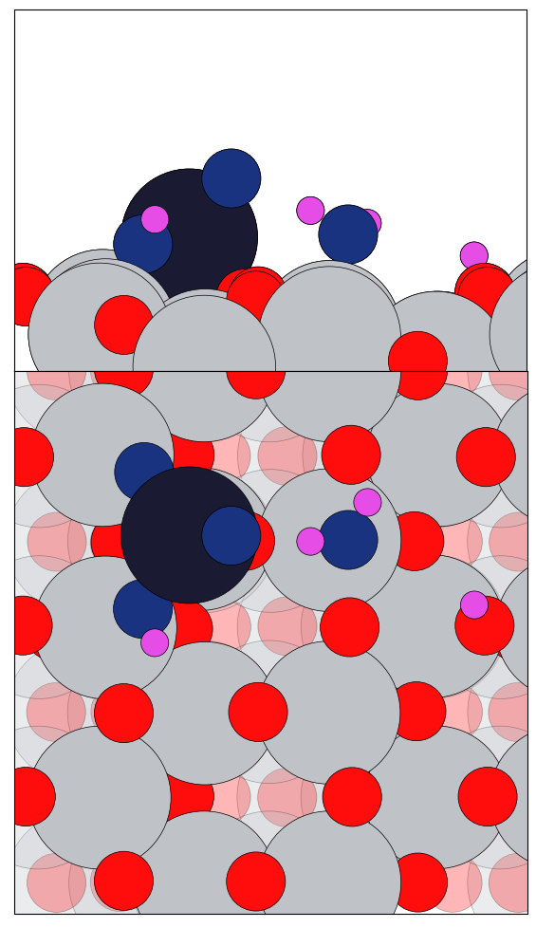
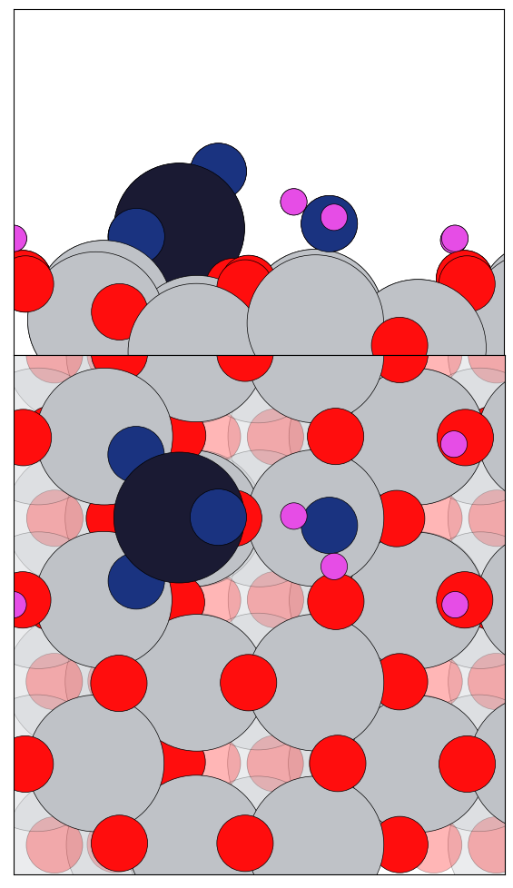
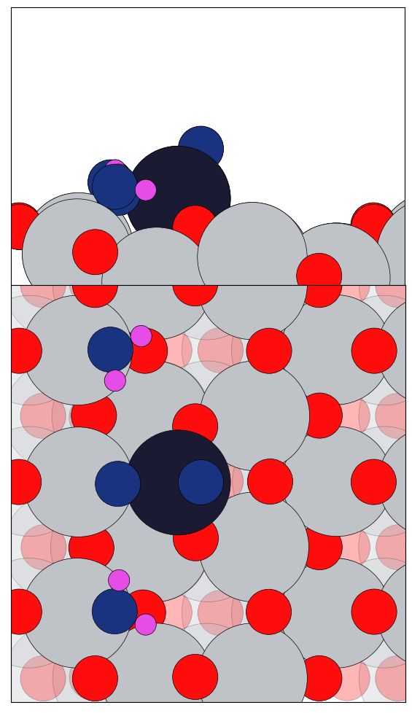
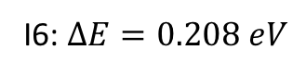
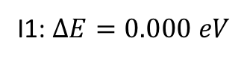
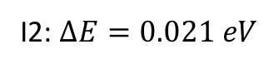
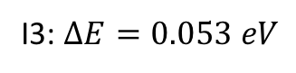
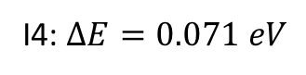
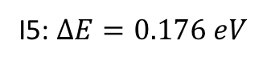
VO₂ + 2H₂O Clusters with O_{v} (1by3 Super cell)
I1: $∆E=0.000 eV$
I2: $∆E=0.021 eV$
I3: $∆E=0.053 eV$
I4: $∆E=0.071 eV$
I5: $∆E=0.176 eV$
I6: $∆E=0.208 eV$

Slide 8
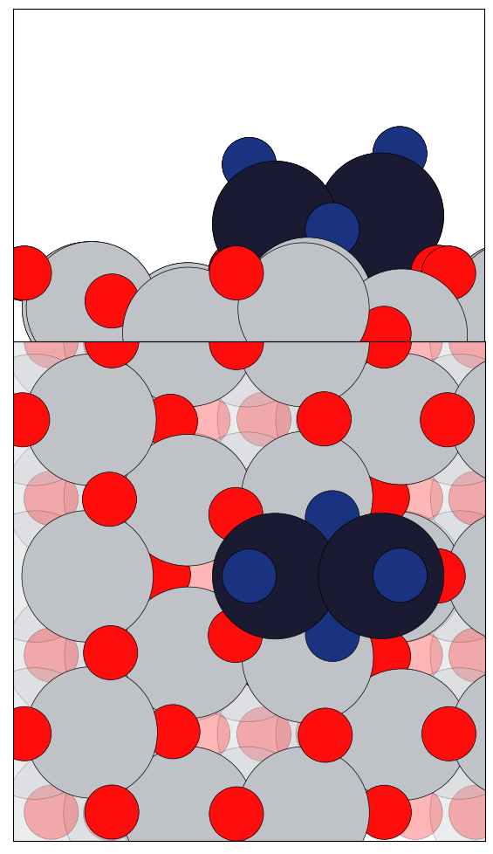
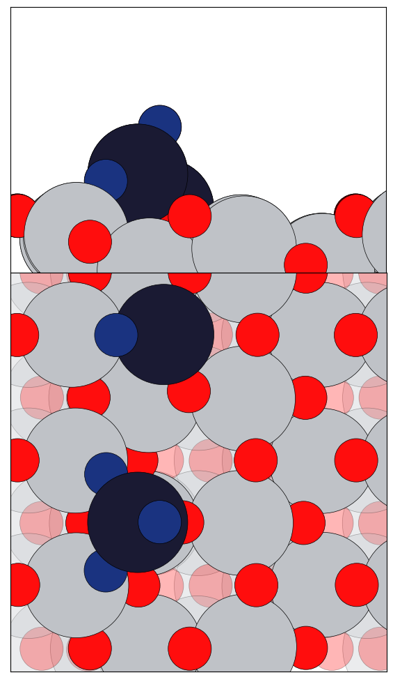
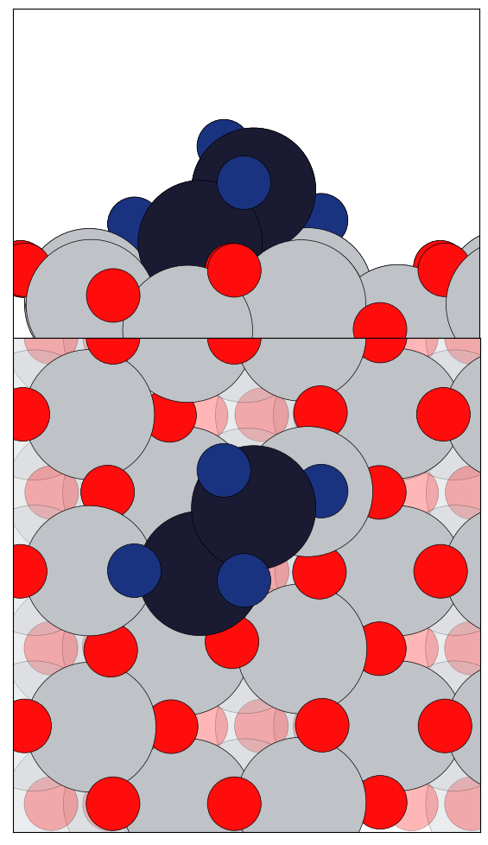
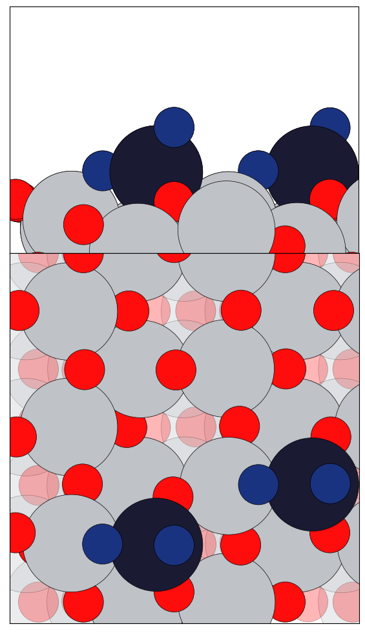
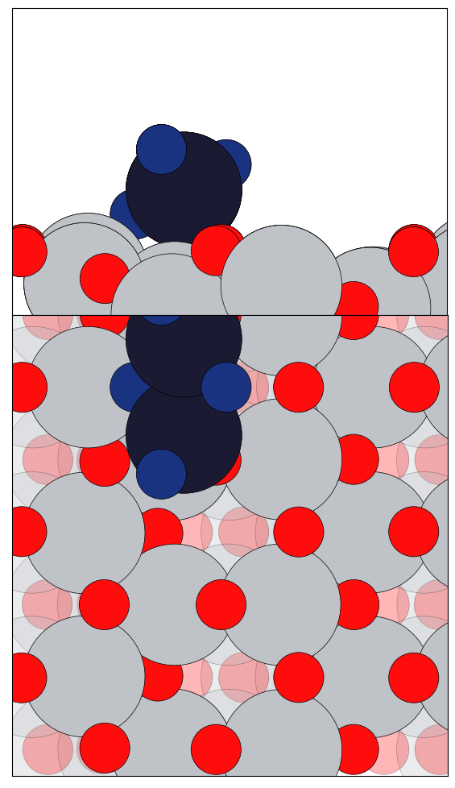
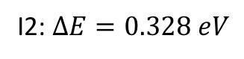
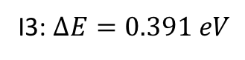
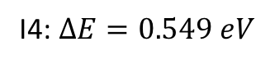
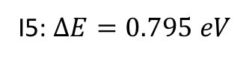
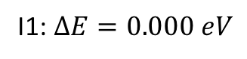
V₂O₄ Clusters with O_{v} (1by3 Super cell)
I1: $∆E=0.000 eV$
I2: $∆E=0.328 eV$
I3: $∆E=0.391 eV$
I4: $∆E=0.549 eV$
I5: $∆E=0.795 eV$

Slide 9
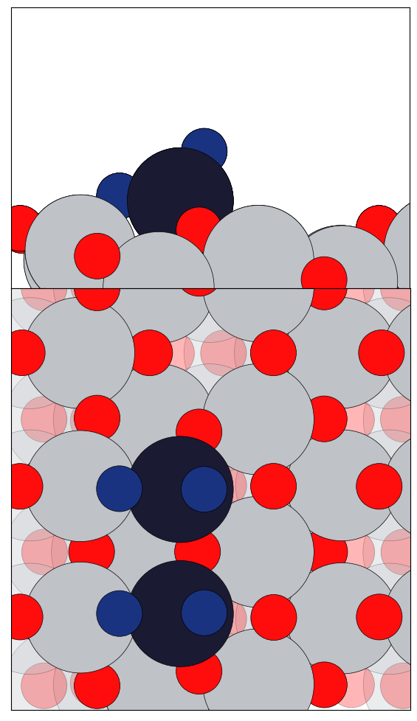
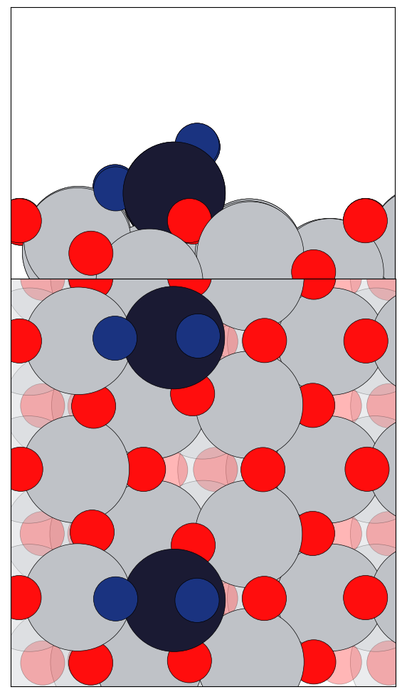
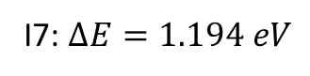
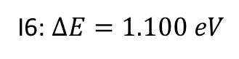
V₂O₄ Clusters with O_{v} (1by3 Super cell)
I6: $∆E=1.100 eV$
I7: $∆E=1.194 eV$

Slide 10
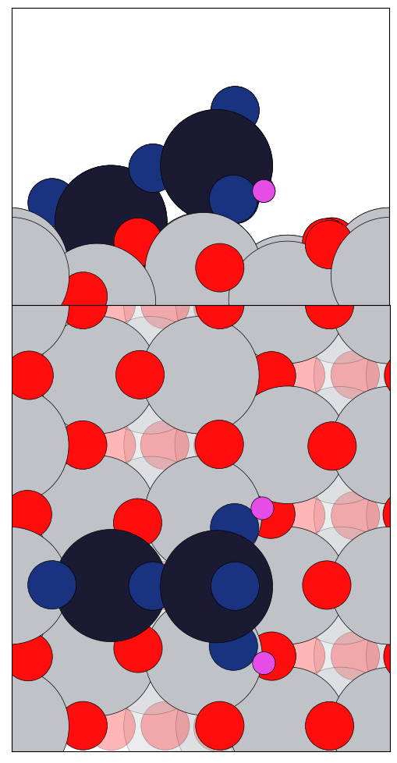
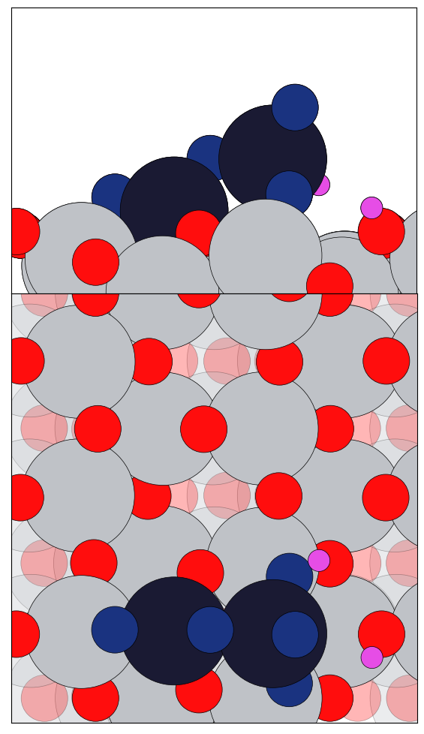
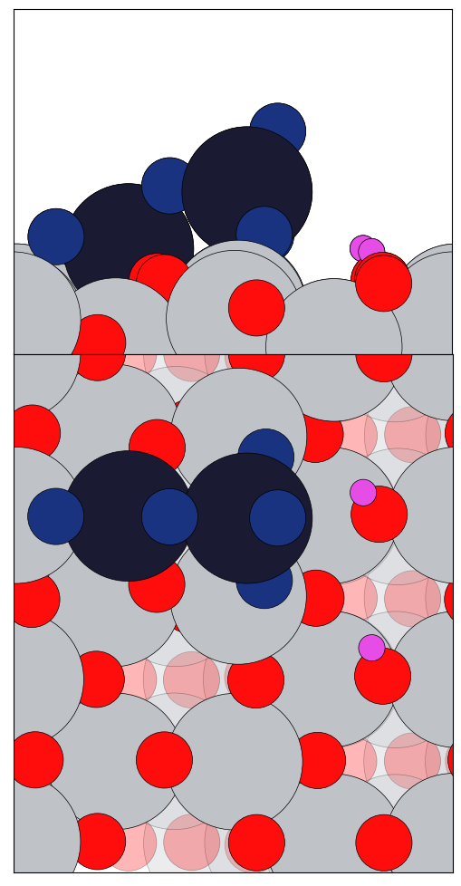
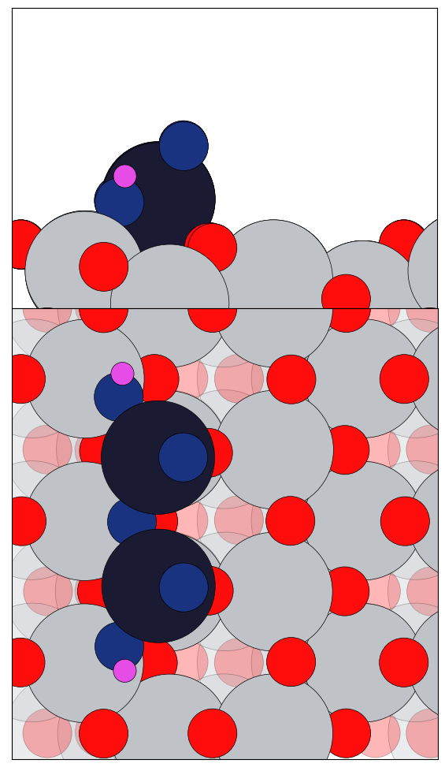
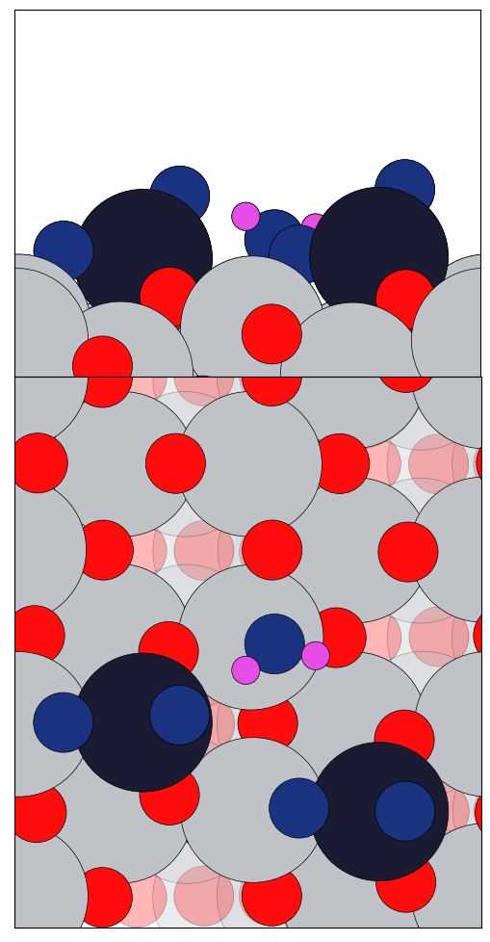
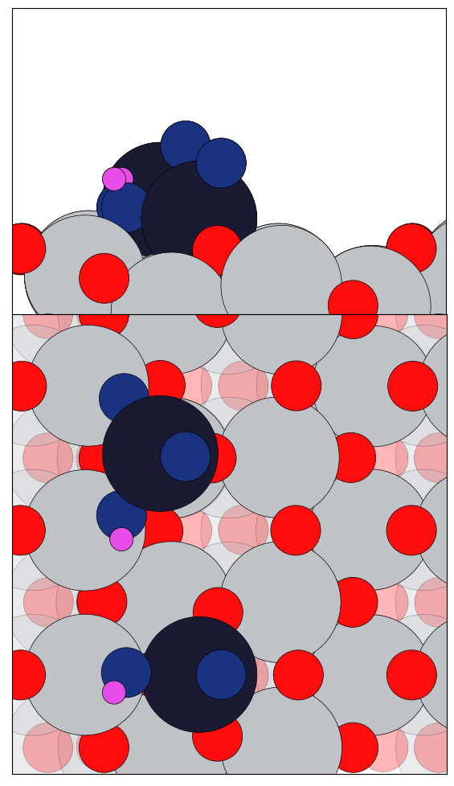
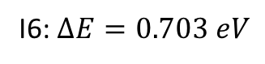
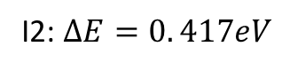
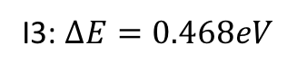
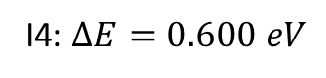
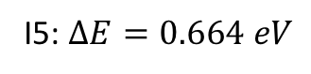
V₂O₄ + H₂O Clusters with O_{v} (1by3 Super cell)
I1: $∆E=0.000 eV$
I2: $∆E=0. 417eV$
I3: $∆E=0.468eV$
I4: $∆E=0.600 eV$
I5: $∆E=0.664 eV$
I6: $∆E=0.703 eV$

Slide 11
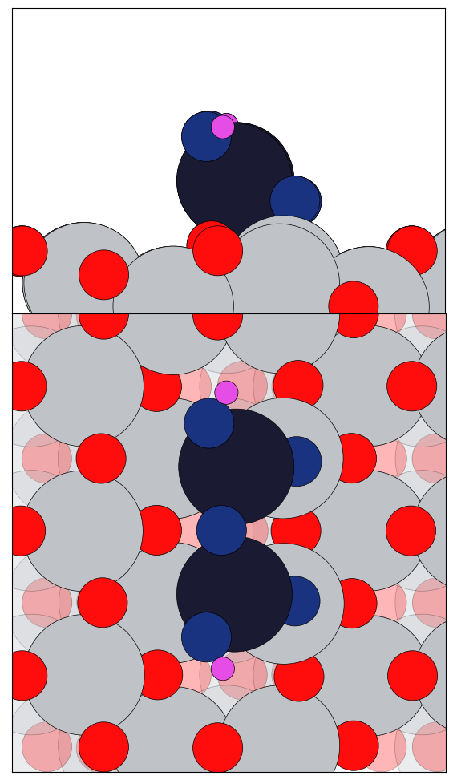







V₂O₄ + H₂O Clusters with O_{v} (1by3 Super cell)
I7: $∆E=0.837 eV$
I8: $∆E=0.931 eV$
I9: $∆E=0.982 eV$
I10: $∆E=1.180 eV$

Slide 12









V₂O₄ + 2H₂O Clusters with O_{v} (1by3 Super cell)
I1: $∆E=0.000 eV$
I2: $∆E=0.409 eV$
I3: $∆E=0.541 eV$
I4: $∆E=0.574 eV$
I5: $∆E=0.633 eV$

Slide 13










V₂O₄ + 2H₂O Clusters with O_{v} (1by3 Super cell)
I6: $∆E=0.803 eV$
I7: $∆E=0.837 eV$
I8: $∆E=0.874 eV$
I9: $∆E=0.989 eV$
I10: $∆E=1.059 eV$

Slide 14










V₂O₅ Clusters with O_{v} (1by4 Super cell)
I1: $∆E=0.000 eV$
I2: $∆E=0.127 eV$
I3: $∆E=0.131 eV$
I4: $∆E=0.257 eV$
I5: $∆E=0.326 eV$

Slide 15












V₂O₅ Clusters with O_{v} (1by4 Super cell)
I6: $∆E=0.420 eV$
I7: $∆E=0.814 eV$
I8: $∆E=1.065 eV$
I9: $∆E=1.164 eV$
I10: $∆E=1.244 eV$
I11: $∆E=2.238 eV$

Slide 16











V₂O₅ Clusters with O_{v} (1by4 cell)
$$V2O5+ H2O \underset{→}{TiO2 \left(101\right) surface O vacancy}$$
I1: $∆E=0.000 eV$
I2: $∆E=0.066 eV$
I3: $∆E=0.076 eV$
I4: $∆E=0.131 eV$
I5: $∆E=0.163 eV$

Slide 17










V₂O₅ Clusters with O_{v} (1by4 cell)
$$V2O5+ H2O \underset{→}{TiO2 \left(101\right) surface O vacancy}$$
I6: $∆E=0.166 eV$
I7: $∆E=0.230 eV$
I8: $∆E=0.271 eV$
I9: $∆E=0.293 eV$
I10: $∆E=0.328 eV$

Slide 18










V₂O₅ Clusters with O_{v} (1by4 cell)
$$V2O5+ H2O \underset{→}{TiO2 \left(101\right) surface O vacancy}$$
I11: $∆E=0.339 eV$
I12: $∆E=0.395 eV$
I13: $∆E=0.427 eV$
I14: $∆E=0.511 eV$
I15: $∆E=0.573 eV$

Slide 19











V₂O₅ Clusters with O_{v} (1by4 Super cell)
$$V2O5+2 H2O \underset{→}{TiO2 \left(101\right) surface O vacancy}$$
I1: $∆E=0.000 eV$
I2: $∆E=0.103 eV$
I3: $∆E=0.171 eV$
I4: $∆E=0.236 eV$
I5: $∆E=0.271 eV$

Slide 20












V₂O₅ Clusters with O_{v} (1by4 Super cell)
$$V2O5+2 H2O \underset{→}{TiO2 \left(101\right) surface O vacancy}$$
I6: $∆E=0.366 eV$
I7: $∆E=0.379 eV$
I8: $∆E=0.392 eV$
I9: $∆E=0.397 eV$
I10: $∆E=0.401 eV$
I11: $∆E=0.534 eV$

Slide 21








V₂O₅ Clusters with O_{v} (1by4 Super cell)
$$V2O5+2 H2O \underset{→}{TiO2 \left(101\right) surface O vacancy}$$
I12: $∆E=0.596 eV$
I13: $∆E=0.749 eV$
I14: $∆E=0.789 eV$
I15: $∆E=1.173 eV$

Slide 22










V₂O₅ Clusters with O_{v} (1by4 Super cell)
$$V2O5+3 H2O \underset{→}{TiO2 \left(101\right) surface O vacancy}$$
$$V2O5+5 H2O \underset{→}{TiO2 \left(101\right) surface O vacancy}$$
I1: $∆E=0.000 eV$
I2: $∆E=0.272 eV$
I1: $∆E=0.000 eV$
I2: $∆E=0.141 eV$

Slide 23







VO₂ + H₂O Clusters (1by2 Super cell)
I1: $∆E=0.000 eV$
I2: $∆E=0.208 eV$
I3: $∆E=0.245 eV$
I4: $∆E=0.364 eV$

Slide 24











VO₂ + 2H₂O Clusters (1by3 Super cell)
I1: $∆E=0.000 eV$
I2: $∆E=0.064 eV$
I3: $∆E=0.191 eV$
I4: $∆E=0.221 eV$
I5: $∆E=0.282 eV$
I6: $∆E=0.333 eV$

Slide 25









V₂O₄ Clusters (1by3 Super cell)
I1: $∆E=0.000 eV$
I2: $∆E=0.207 eV$
I3: $∆E=0.290 eV$
I4: $∆E=0.466 eV$
I5: $∆E=0.814 eV$

Slide 26




V₂O₄ Clusters (1by3 Super cell)
I6: $∆E=1.087 eV$
I7: $∆E=1.101 eV$

Slide 27












V₂O₄ + H₂O Clusters (1by3 Super cell)
I1: $∆E=0.000 eV$
I2: $∆E=0.221 eV$
I3: $∆E=0.415 eV$
I4: $∆E=0.568 eV$
I5: $∆E=0.615 eV$
I6: $∆E=0.760 eV$

Slide 28









V₂O₄ + 2H₂O Clusters (1by3 Super cell)
I1: $∆E=0.000 eV$
I2: $∆E=0.436 eV$
I3: $∆E=0.597 eV$
I4: $∆E=0.642 eV$
I5: $∆E=0.736 eV$

Slide 29










V₂O₄ + 2H₂O Clusters (1by3 Super cell)
I6: $∆E=0.801 eV$
I7: $∆E=0.818 eV$
I8: $∆E=0.821 eV$
I9: $∆E=0.917 eV$
I10: $∆E=0.972 eV$

Slide 30










V₂O₅ Clusters (1by4 Super cell)
I1: $∆E=0.000 eV$
I2: $∆E=0.226 eV$
I3: $∆E=0.290 eV$
I4: $∆E=0.409 eV$
I5: $∆E=0.414 eV$

Slide 31












V₂O₅ Clusters (1by4 Super cell)
I6: $∆E=0.600 eV$
I7: $∆E=1.016 eV$
I8: $∆E=1.231 eV$
I9: $∆E=1.350 eV$
I10: $∆E=1.430 eV$
I11: $∆E=1.481 eV$

Slide 32













V₂O₅ Clusters (1by4 Super cell)
$$V2O5+ H2O \underset{→}{TiO2 \left(101\right) surface}$$
I1: $∆E=0.000 eV$
I2: $∆E=0.044 eV$
I3: $∆E=0.072 eV$
I4: $∆E=0.132 eV$
I5: $∆E=0.155 eV$
I6: $∆E=0.221 eV$

Slide 33










V₂O₅ Clusters (1by4 Super cell)
$$V2O5+ H2O \underset{→}{TiO2 \left(101\right) surface}$$
I7: $∆E=0.260 eV$
I8: $∆E=0.287 eV$
I9: $∆E=0.335 eV$
I10: $∆E=0.371 eV$
I11: $∆E=0.452 eV$

Slide 34













V₂O₅ Clusters (1by4 Super cell)
$$V2O5+2 H2O \underset{→}{TiO2 \left(101\right) surface}$$
I1: $∆E=0.000 eV$
I2: $∆E=0.145 eV$
I3: $∆E=0.196 eV$
I4: $∆E=0.254 eV$
I5: $∆E=0.341 eV$
I6: $∆E=0.352 eV$

Slide 35






V₂O₅ Clusters (1by4 Super cell)
$$V2O5+2 H2O \underset{→}{TiO2 \left(101\right) surface}$$
I7: $∆E=0.399 eV$
I8: $∆E=0.462 eV$
I9: $∆E=0.684 eV$

Slide 36












V₂O₆ Clusters (1by3 Super cell)
I1: $∆E=0.00 eV$
I2: $∆E=0.204 eV$
I3: $∆E=0.254 eV$
I4: $∆E=0.386 eV$
I5: $∆E=0.388 eV$
I6: $∆E=0.398 eV$

Slide 37








V₂O₆ Clusters (1by3 Super cell)
I7: $∆E=0.479 eV$
I8: $∆E=0.496 eV$
I9: $∆E=1.373 eV$
I10: $∆E=1.912 eV$

Slide 38






Before H₂O exposer
During H₂O exposer
After H₂O exposer
$$→$$
$$↔$$
Global minimum
I2: $∆E=0.100 eV$
Global minimum
This becomes GM if we have
more than 2 H₂O

Slide 39










Adsorption Energies By addition of H₂O Molecule
E₁^{Ads}
E_{ads} = E_{tot.} (n H₂O + V₂O₅) / a-TiO₂(101)) - n E_{tot}(H₂O) - E_{tot}((VO)_{x} + a-TiO₂(101))
 | E_{ads} (1 H₂O) (eV) | E_{ads} (2 H₂O) (eV) | E_{ads} (3 H₂O) (eV) | E_{ads} (5 H₂O) (eV)
E₁^{Ads} | -0.871 | 1.546
E₂^{Ads} | -1.266
E₃^{Ads} | -1.013
E₄^{Ads} | -0.912 | -1.945 | -2.929 | -3.943
E₅^{Ads} | -1.982 | -2.875 | -3.694 | -4.838
H₂O
H₂O
$$→$$
$$→$$
$$∆E=0.000 eV$$
$∆E=0.076 eV$
$∆E=0.271 eV$
E₂^{Ads}
E₃^{Ads}
H₂O
$$→$$
H₂O
$$→$$
$∆E=0.000 eV$
$$∆E=0.131 eV$$
$∆E=0.066 eV$

Slide 40















E₄^{Ads}
H₂O
H₂O
2 H₂O
H₂O
$$→$$
$$→$$
$$→$$
$$→$$
$$∆E=0.127 eV$$
$$∆E=0.155 eV$$
$∆E=0.000 eV$
$$∆E=0.000 eV$$
$∆E=0.000 eV$
E₅^{Ads}
2 H₂O
H₂O
H₂O
H₂O
$$→$$
$$→$$
$$→$$
$$→$$
$$∆E=1.164 eV$$
$∆E=0.131 eV$
$∆E=0.103 eV$
$∆E=0.272 eV$
$∆E=0.141 eV$

Slide 41
Points to Conclude
1) Effect of O-vacancy:
There is gain in energy due to O-vacancy in the subcell surface. The gain in energy is around in the range of 0.05 eV to 0.200 eV depends upon the structure. De to this there is change in the order of low-lying isomers which are in the range of meV.
2) Dissociation capability of H2O due to size of Cluster:
In case of VO2 cluster, it requires 0.131 eV/1 H2O and 0.053 eV/2 H2O energy to dissociate the H2O. And In case of V2O4 and V2O5, dissociated H2O strcture is the GM.
3) Surface Effect on H2O dissociation:
We did not observed the surface hydroxyls within 0.2 eV energy range from GM. Mostly Vanadium oxide clusters are responsible for H2O dissociation.

Slide 42
Points to Conclude
4) Dissociation of V2O5 clusters and Non-dissociation of V2O4 clusters:
In case of V2O5 clusters during H2O exposure, the cluster get dissociated in two paces (Ex: VO3H) and in case of V2O4 during H2O exposure also the clusters get remains intact due to keeping of +4 or +5 state of Vanadium oxidation state.
5) Restructuring of V2O5 cluster during H2O exposure:
The re-structuring of V2O5 cluster during water exposure is due to dissociation of H2O makes the V2O5 cluster in to two VO3H clusters and these two VO3H clusters can have different arrangements.

Slide 43

Suggestions for a structure
2xV
6XO
4XH

Slide 44

Suggestions for a structure
2xV
6XO
2XH

Slide 45

Suggestions for a structure
2xV
6XO
2XH

Slide 46


2xV
5XO
2XH
Placement of H is very uncertaint

Slide 47

2xV
5XO

Slide 48
1 X H2O
H2O

Slide 49
H2O
1 X H2O

Slide 50
1 X H2O
2 X H
H2O

Slide 51
model suggestions
= V
2 X VO2
2 different configurations
2 X VO3H + 2X H_bridge
V2O5H2

Slide 52



Slide 53
2xH2O
H2O

